Slide 2
CHAPTER 4
Analyzing Financial Statements

Slide 3
Ratio Analysis
Quick Links
Financial Statement Analysis
The DuPont System, ROA, ROE
Benchmarks
Limitations of Ratio Analysis
Exhibits

Slide 4
Perspectives on
Financial Statement Analysis
A firm’s financial statements can be analyzed from perspective of different stakeholders.
Important perspectives:
Stockholder
  Manager
Creditor

Slide 5
Perspectives on
Financial Statement Analysis
Stockholders’ perspective
Centers on value of stock held
Interest in the financial statement is to gauge cash flows firm will generate from operations
Allows determination of firm’s profitability, return for that period, and likely dividends

Slide 6
Perspectives on
Financial Statement Analysis
Managers’ perspective
Interest in firm’s financial statement is similar to stockholders’
Manager’s job security depends on firm’s performance
Management gets feedback on investing, financing, and working capital decisions by identifying trends in various accounts reported in financial statements.

Slide 7
Perspectives on
Financial Statement Analysis
Creditors’ perspective
Focus on getting loans repaid and receiving interest payments on time.
  Criteria include:
    Amount of debt firm has
  Ability to meet short-term obligations
  Ability to generate sufficient cash flows to meet all legal obligations, debt repayment, and interest payments
Notes:
MAIN POINTS AND SUB-POINTS? SEE NEXT SLIDES

Slide 8
Guidelines for
Financial Statement Analysis
Main Concern
  From whose perspective firm analysis is done
    management, shareholder or creditor
  Use only audited financial statements if possible
  Perform analysis over 3-5 year period – time-trend analysis

Slide 9
Guidelines for
Financial Statement Analysis
Main Concern (cont.)
  Compare firm’s performance to direct competitors’ performance
  Perform a benchmark analysis comparing it to most relevant competitors – American Airlines with Delta or United Airlines.

Slide 10
Common Size
Financial Statements
Common-Size Balance Sheets
  Each asset and liability item on balance sheet is standardized by dividing by total assets
  Accounts then represented as percentages of total assets
Go to Exhibit 4.1

Slide 11
Common Size
Financial Statements
Common-Size Income Statement
  Each income statement item standardized by dividing it by dollar amount of net sales
  Each income statement item now indicated as percent of sales
Go to Exhibit 4.2

Slide 12
Ratio Analysis
Why Ratios Are Better Measures
A ratio is computed by dividing one balance sheet or income statement item by another.
Variety of ratios can be computed to focus on specialized aspects of firm’s performance
Choice of scale determines story garnered from ratio
Go to Exhibit 4.3

Slide 13
Ratio Analysis
Why Ratios Are Better Measures
Different ratios calculated based on type of firm being analyzed or kind of analysis being performed
Ratios may be computed to measure liquidity, efficiency, leverage, profitability, or market value performance.

Slide 14
Liquidity Ratios
Measures ability of firm to meet short-term obligations with short-term assets, without endangering the firm
Two commonly used ratios to measure liquidity:
  Current ratio
  Quick ratio

Slide 15

Liquidity Ratios
Current ratio calculated by dividing current assets by current liabilities
  Amount of current assets firm has per dollar of current liabilities
  Higher number = more liquidity

Slide 16
Liquidity Ratios
Quick (acid-test) ratio calculated by dividing most liquid of current assets by current liabilities
  inventory subtracted from total current assets determines most liquid assets
  Amount of liquid assets firm has per dollar of current liabilities
  Higher number = more liquidity

Slide 17

Liquidity Ratios
Quick ratios typically smaller than current ratios for firms carrying significant inventory (e.g. mfg)
Firms carrying little inventory (e.g. service) will see no significant difference between the two

Slide 18
Efficiency Ratios
Sometimes called asset turnover ratios
Measure how efficiently firm’s management uses assets to generate sales

Slide 19
Efficiency Ratios
Used by management to identify areas of inefficiency
Used by creditors to determine speed of converting inventory to receivables
  Receivables convert to cash to help firm meet debt obligations
Efficiency ratios focus on inventory, receivables and use of fixed and total assets

Slide 20

Efficiency Ratios
Inventory turnover ratio - measures how many times inventory turned over into saleable products
  Year-end inventory used;
  Use average inventory if significant inventory level changes during year
  More often a firm can turn over inventory, the better
  Too high or too low a turnover could be warning sign

Slide 21

Efficiency Ratios
Days’ sales in inventory ratio also builds on inventory turnover ratio
  Measures number of days firm takes to turn over inventory
  The smaller the number, the faster the firm turns over inventory, more efficient it is

Slide 22

Efficiency Ratios
Accounts receivables turnover ratio measures how quickly firm collects on its credit sales
  The higher the frequency of turnover, the faster it converts credit sales into cash flows

Slide 23

Efficiency Ratios
Days Sales Outstanding measures number of days firm takes to convert receivables into cash
  The fewer the days, the more efficient the firm
  Note: an overzealous credit department may offend firm’s customers

Slide 24
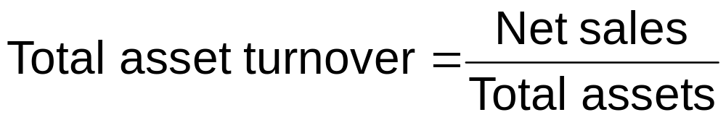
Asset Turnover Ratios
Total asset turnover ratio measures level of sales firm generates per dollar of total assets
The higher the turnover, the more efficiently management is using total assets
More relevant for service industry firms

Slide 25

Asset Turnover Ratios
Fixed asset turnover ratio measures level of sales firm generates per dollar of fixed assets
  Higher the fixed asset turnover, the more efficiently management uses plant and equipment
  More relevant for equipment intensive firms (e.g. mfg)

Slide 26
Leverage Ratios
Leverage ratios reflect ability of firm and owners to use equity to generate borrowed funds
Financial leverage refers to use of long-term debt in firm’s capital structure

Slide 27
Leverage Ratios
Use of debt increases shareholders’ returns; tax benefits from interest payments on debt
Two sets of ratios can analyze leverage:
  Debt ratios quantify use of debt in capital structure;
  Coverage ratios measure firm’s ability to meet debt obligations

Slide 28

Leverage Ratios
Total debt ratio calculated using short-term and long-term debt.
The higher the amount of debt, the higher the firm’s leverage, and the more risky it is.

Slide 29

Leverage Ratios
Debt to equity ratio is a second leverage ratio, measuring amount of debt per dollar of equity

Slide 30

Leverage Ratios
Equity multiplier or leverage multiplier reveals amount of assets firm has for every dollar of equity
Best measure of firm’s ability to leverage shareholders’ equity with borrowed funds

Slide 31
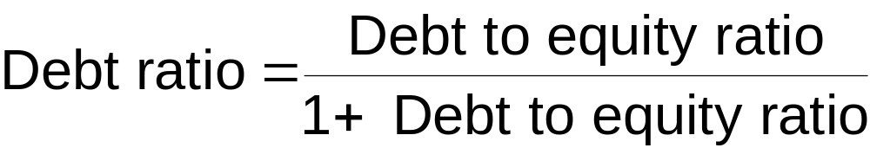
Other Leverage Relationships
Equity multiplier = 1 + debt to equity ratio

Slide 32
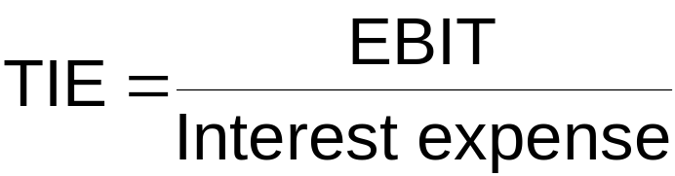

Coverage Ratios
Times interest earned measures number of dollars in operating earnings firm generates per dollar of interest expense
Cash coverage ratio measures amount of cash firm has to meet its interest payments

Slide 33


Profitability Ratios
Gross profit margin measures amount of gross profit generated per dollar of net sales
Operating profit margin measures the amount of operating profit generated by firm for each dollar of net sales

Slide 34


Profitability Ratios
Net profit margin measures amount of net income after taxes generated by firm for each dollar of net sales
In each case, the higher the ratio, the more profitable the firm.
Management and creditors likely to focus on these profitability measures; shareholders likely to concentrate on two others

Slide 35

Profitability Ratios
Return on assets (ROA) ratio measures amount of net income per dollar of total assets
  EBIT return on assets, variation of this ratio, is powerful measure of return;
  Reveals how efficiently management utilized assets under their command
  Measures amount of EBIT per dollar of total assets

Slide 36

Profitability Ratios
Return on equity (ROE) ratio measures dollar amount of net income per dollar of shareholders’ equity
  For firm with no debt, ROA = ROE
  For firm with debt, ROE >ROA

Slide 37
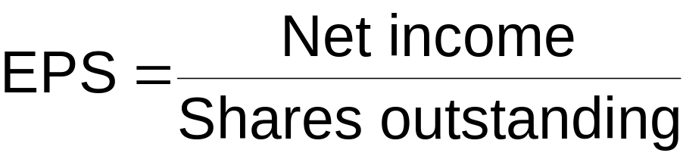
Market Value Ratios
The following ratios reveal how market views company’s liquidity, efficiency, leverage, profitability
Earnings per share (EPS) ratio measures income after taxes generated by firm for each share outstanding

Slide 38

Market Value Ratios
Price-earnings (P/E) ratio ties firm’s earnings per share to price per share
  P/E ratio reflects investors’ expectations of firm’s earnings future growth

Slide 39
The DuPont System
Diagnostic Tool
Set of related ratios that links balance sheet and income statement
Diagnostic tool for evaluating firm’s financial health
Used by management and shareholders to understand factors that drove firm’s ROE
Based on two equations that relate firm’s ROA and ROE

Slide 40
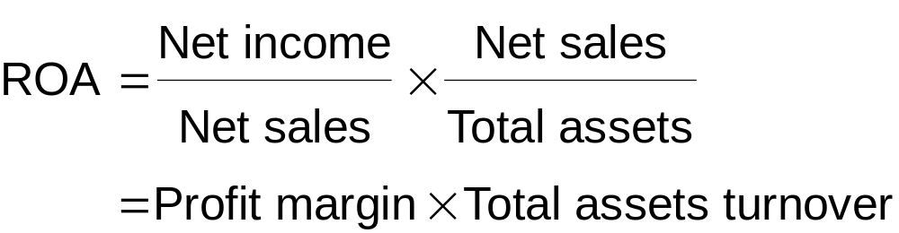
The ROA Equation
Return on assets (net income/total assets) can be broken down into two components:
  Profit margin
  Total assets turnover ratio
Net profit margin measures management’s ability to
generate sales & manage operating expenses
Go to Exhibit 4.4

Slide 41
The ROA Equation
Total asset turnover reveals how efficiently management uses assets under its command; how much output can be generated with a given asset base. Thus, asset turnover measures asset use efficiency.
The ROA equation says if management wants to increase firm’s ROA, it can increase profit margin, asset turnover, or both.
Management can examine a poor ROA and determine whether the problem is operating efficiency or asset use efficiency.

Slide 42
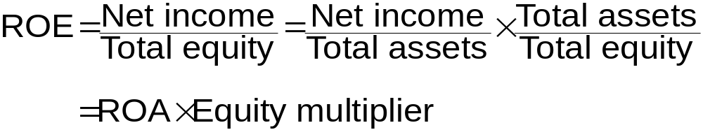
The ROA Equation
This equation is simply a restatement of equation 4.18.
ROE is determined by firm’s ROA and its use of leverage
  firm with small ROA can magnify by using higher leverage to get higher ROE

Slide 43
The DuPont Equation
Shows that a firm’s ROE is determined by three factors:
  Net profit margin, which measures firm’s operating efficiency
  Total asset turnover, which measures firm’s asset use efficiency
  The equity multiplier, which measures firm’s financial leverage
Go to Exhibit 4.5

Slide 44
The DuPont Equation
Analyzing firm’s financial performance will reveal inefficiencies and strengths
Weak operational efficiency calls for closer look at firm’s income statement items
Asset turnover or leverage problems shift focus to balance sheet

Slide 45
ROE as a Goal
Those who do not agree that they are the same identify three key weaknesses:
  ROE based on after-tax earnings, not cash flows
  ROE does not consider risk
  ROE ignores size of initial investment as well as future cash flows

Slide 46
ROE as a Goal
Those who believe that they are consistent propose:
  ROE allows management to break down performance, identify areas of strengths and weaknesses
  ROE is highly correlated with shareholder wealth maximization.

Slide 47
Selecting a Benchmark
A ratio analysis becomes relevant only when compared against a benchmark.
Financial managers can create a benchmark for comparison in three ways
1. Time-trend
2. Industry average
3. Peer group

Slide 48
Selecting a Benchmark
Time-trend analysis
Based on firm’s historical performance
Allows management to examine each ratio over time, determine whether trend is good or bad for firm

Slide 49
Selecting a Benchmark
Industry average analysis
Another way of developing benchmark
Firms in same industry grouped by size, sales, and product lines, to establish benchmark ratios
Can identify industry groups with Standard Industrial Classification (SIC) system

Slide 50
Selecting a Benchmark
Peer group analysis
Instead of selecting an entire industry, management may select firms similar in size or sales, or who compete in same market
Average ratios of this peer group would then be used as benchmark
Peer groups can be only 3 or 4 firms, depending on industry

Slide 51
Limitations of Ratio Analysis
Ratio analysis depends on accounting data based on historical costs
No theoretical backing in making judgments based on financial statement and ratio analysis
When doing industry or peer group analysis one often encounters large, diversified firms that do not fit into any one SIC code

Slide 52
Limitations of Ratio Analysis
Time trend analysis could be distorted by financial statements affected by inflation
Multinational firms deal with many accounting standards
  Difficult to compare financial reports
Even among domestic firms, differences in accounting practices make comparisons difficult
  FIFO versus LIFO

Slide 53
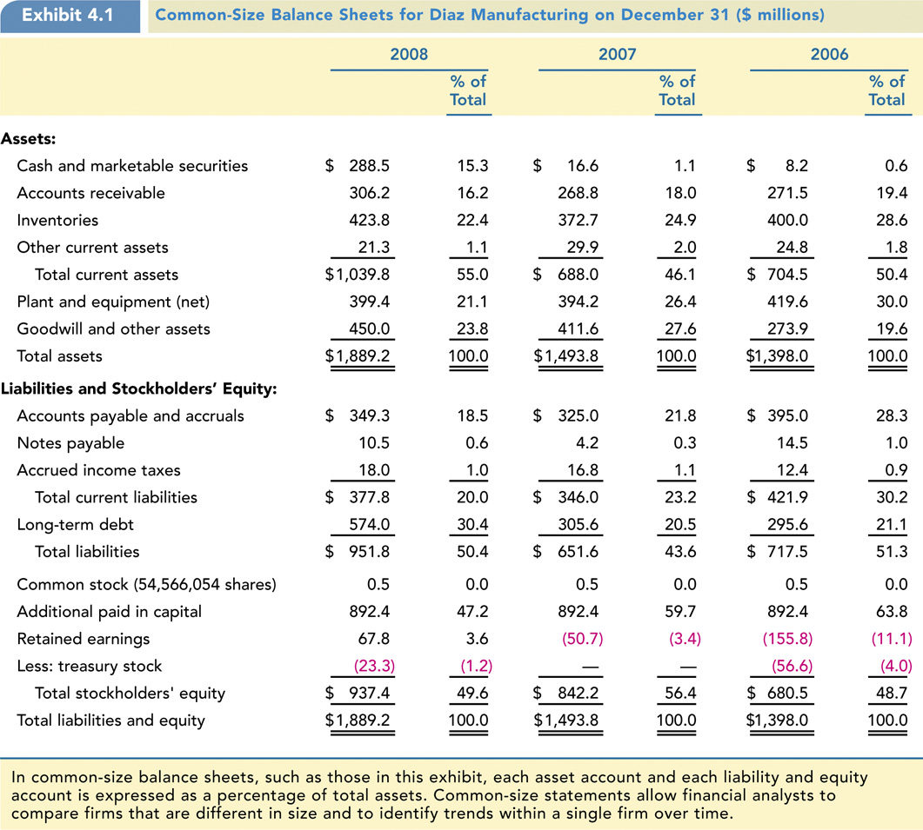
Exhibit 4.1: Common-Size Balance Sheets

Slide 54
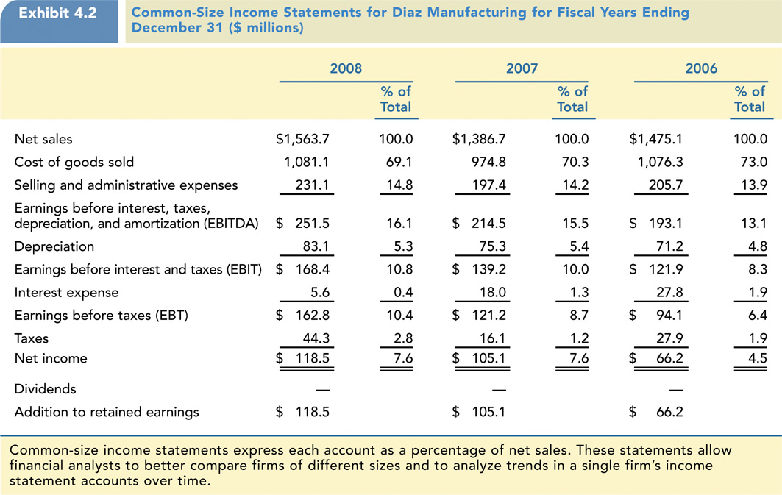
Exhibit 4.2: Common-Size Income Statements

Slide 55
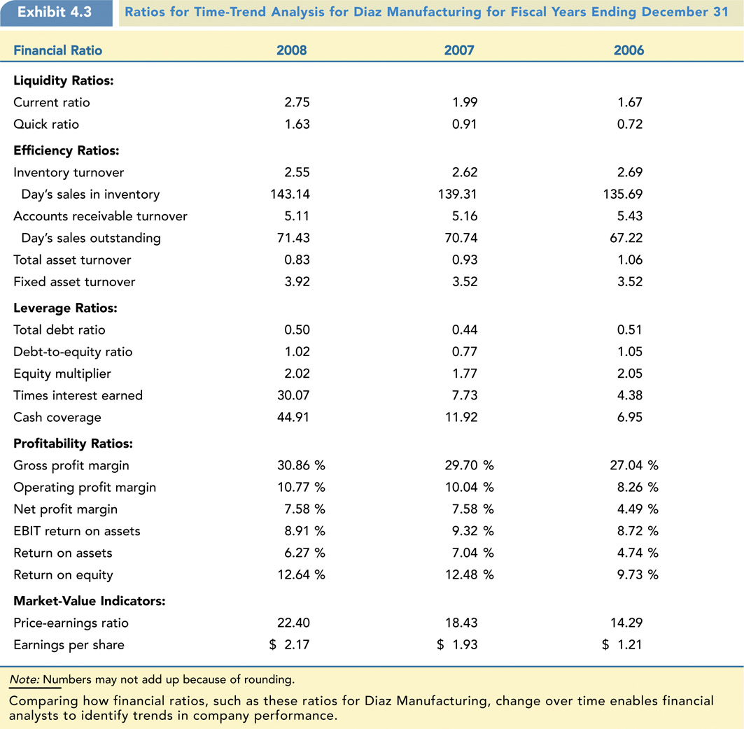
Exhibit 4.3: Ratios for Time-Trend Analysis

Slide 56
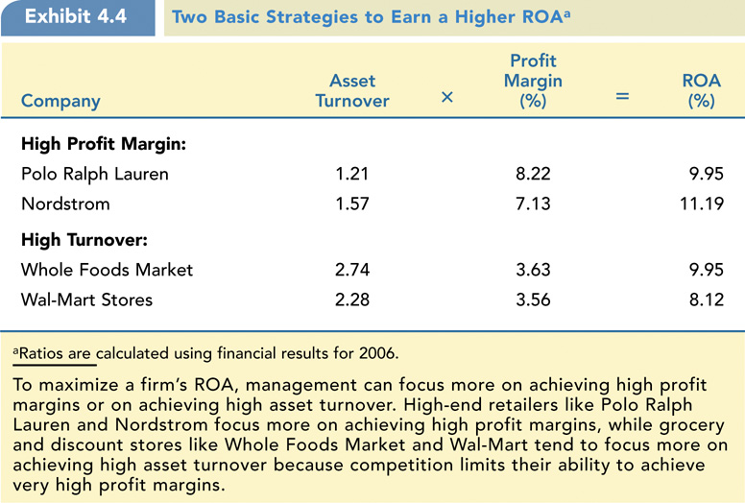
Exhibit 4.4: Two Basic Strategies to Earn a Higher ROA

Slide 57
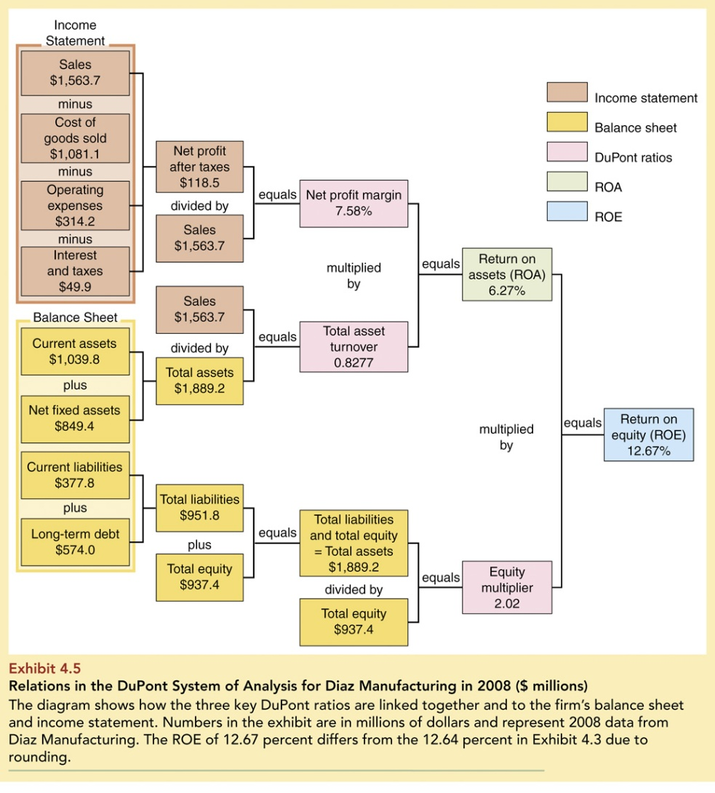
Exhibit 4.5: Relations in the DuPont System of Analysis

Slide 58
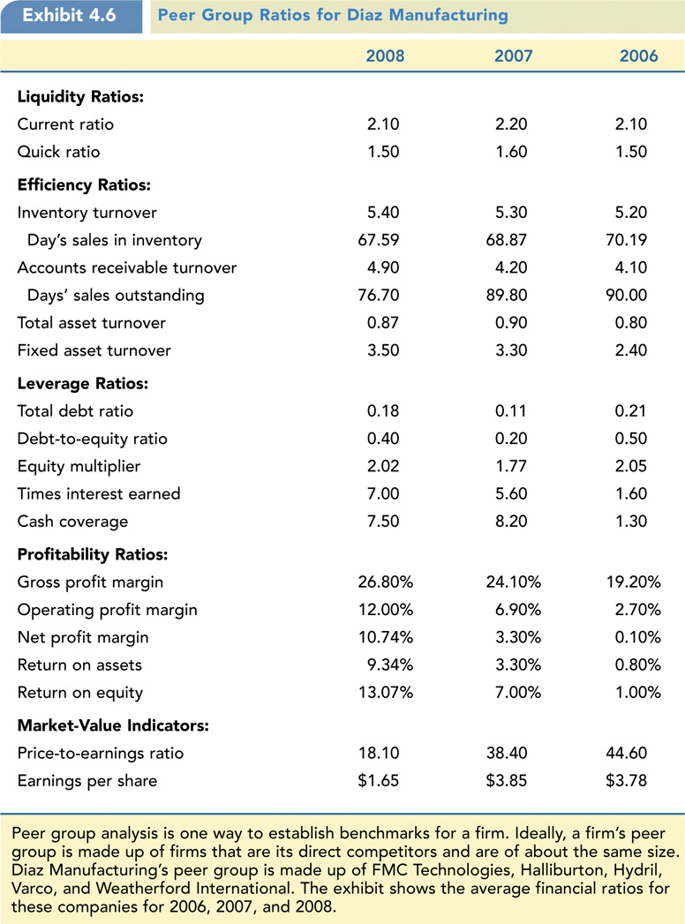
Exhibit 4.6: Peer Group Ratios for Diaz Manufacturing

Slide 59
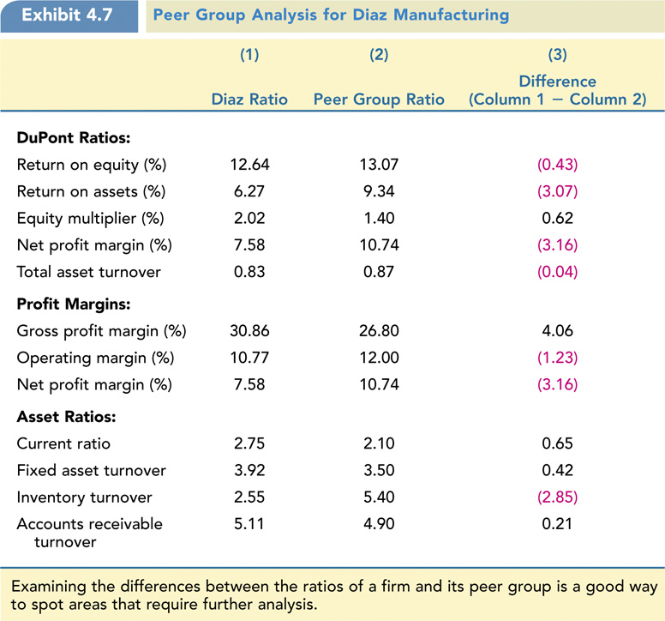
Exhibit 4.7: Peer Group Analysis for Diaz Manufacturing

